Slide 1
Technology Today
Basic 12 - Unit 11a – Computers are everywhere

Slide 2
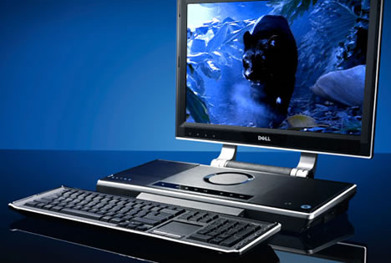

Slide 3
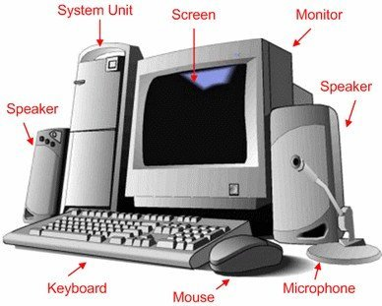

Slide 4
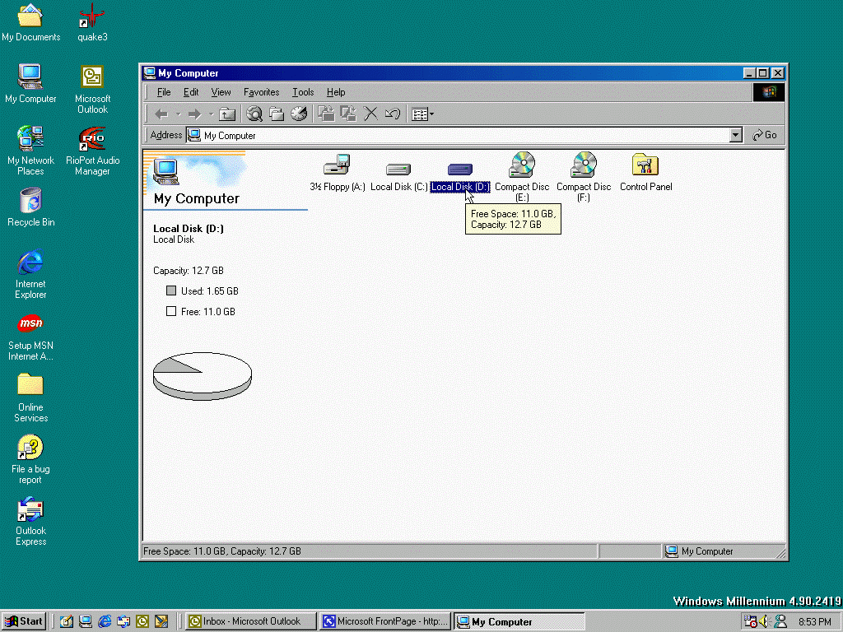

Slide 5
